Slide 1

Platform Guide

Slide 2
Introduction
Thank you for choosing Maxconnex.
Maxconnex is more than just a video platform, it’s a comprehensive fleet management solution. Maxconnex integrates advanced alert management, cargo box, automated fleet operations, helping you streamline workflows, enhance safety and improve efficiency.
Additionally, Maxconnex offers greater flexibility in customization and operational control, including traffic and storage management, allowing you to optimize costs and adapt to your fleet’s specific needs.
This guide provides step-by-step instructions on how to use our Maxconnex live view platform.

Slide 3
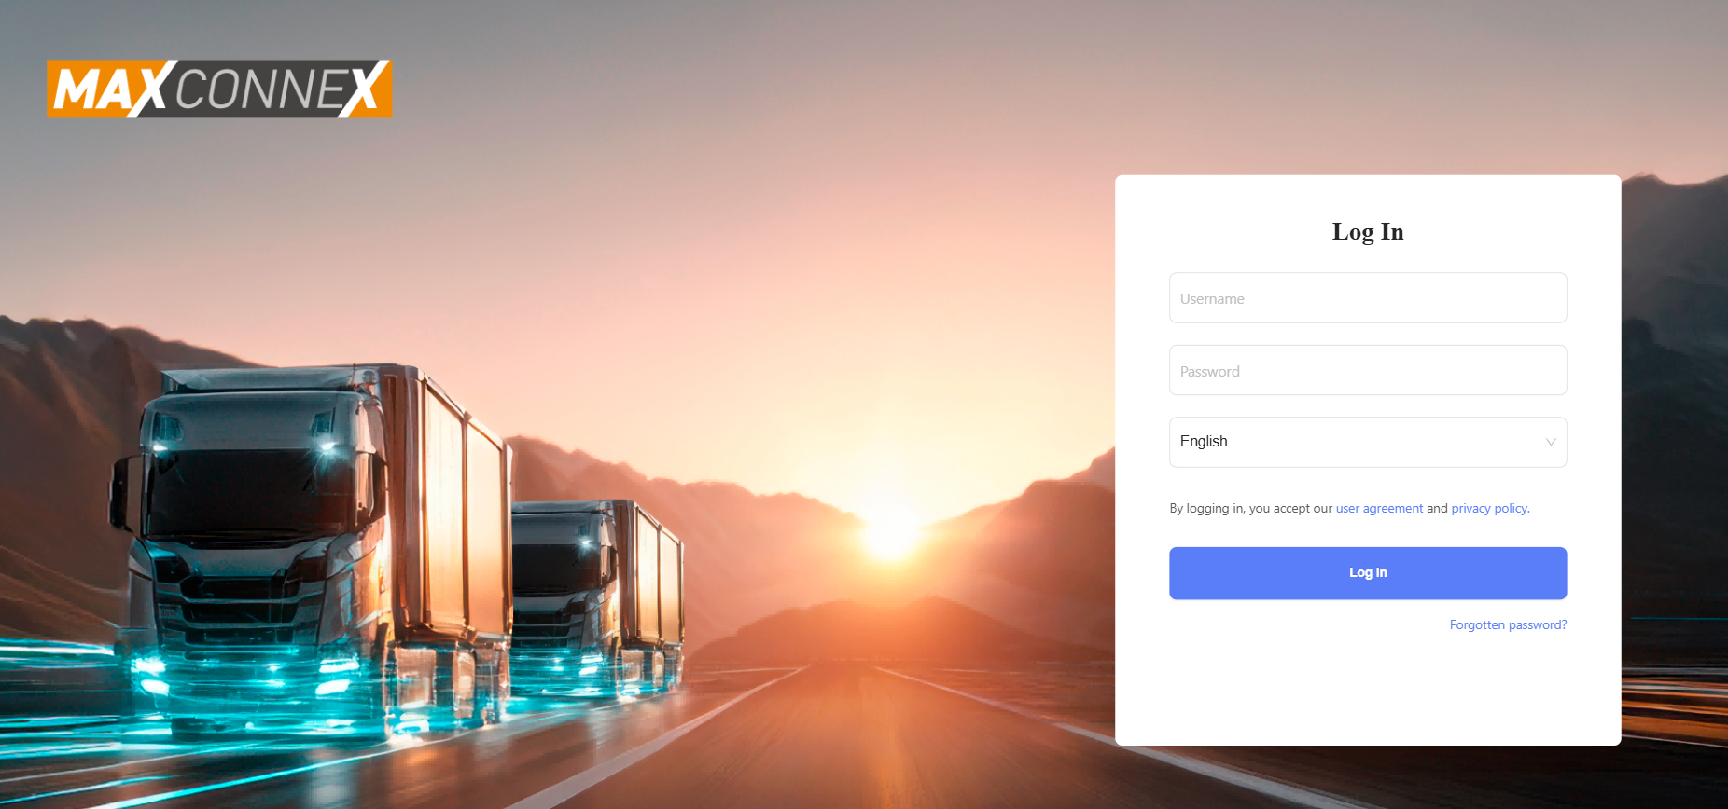
Login Page
Login and password details will be given to you either by your account manager here at Motormax or by your chosen installer.
These will be followed by a Captcha test and might ask for two-factor verification via email.
If this happens you will expect an email from ‘cloud-platform@streamax.com’. Make sure to check your junk folder for this.

Slide 4
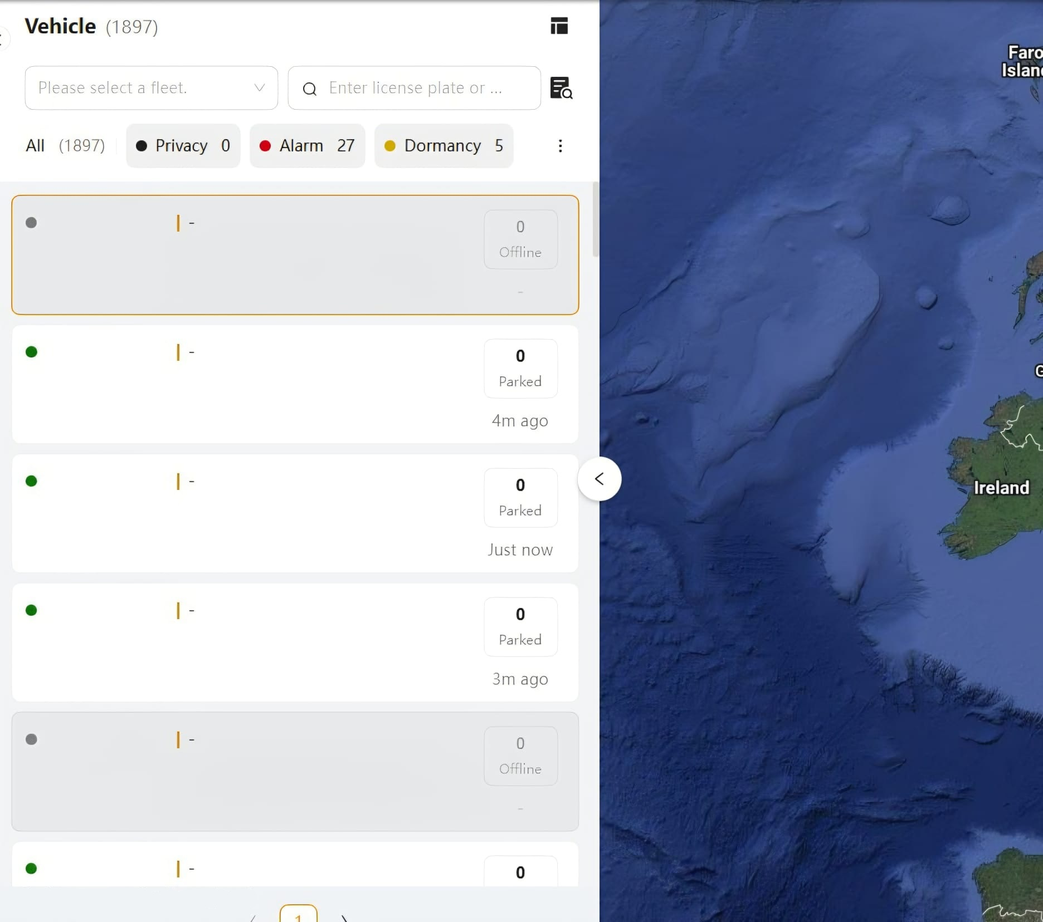
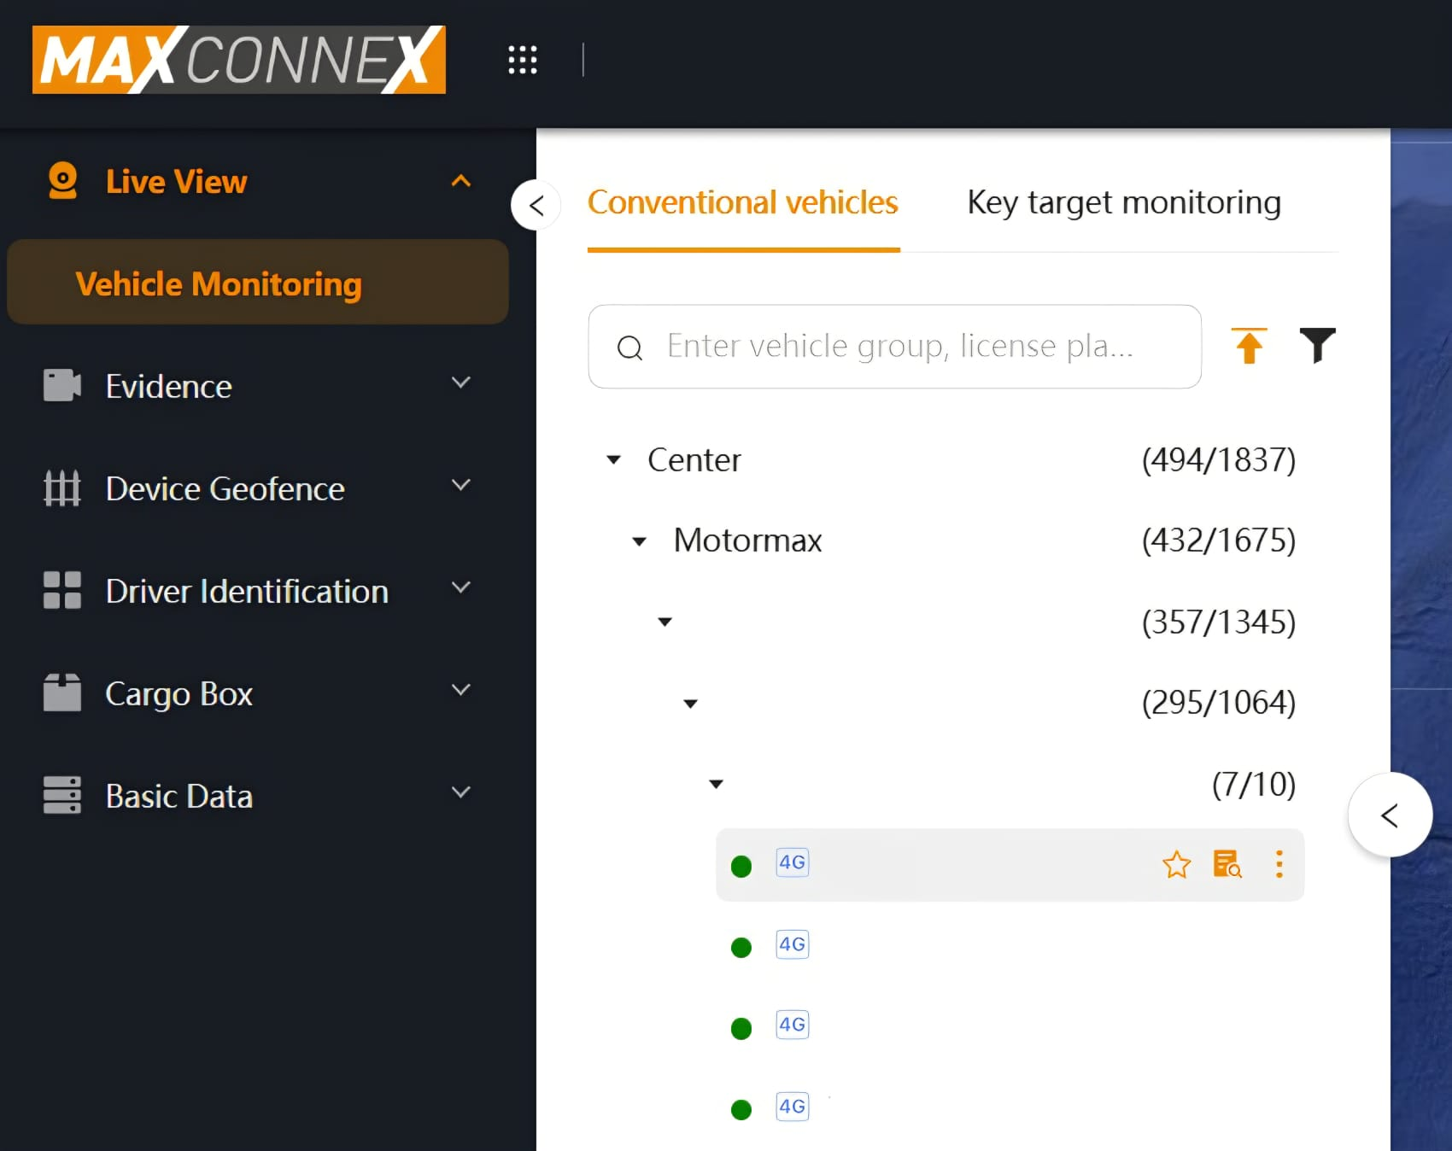
Viewing Live Vehicles
When viewing live vehicles, you have the option to change between two layouts by pressing this button

Slide 5
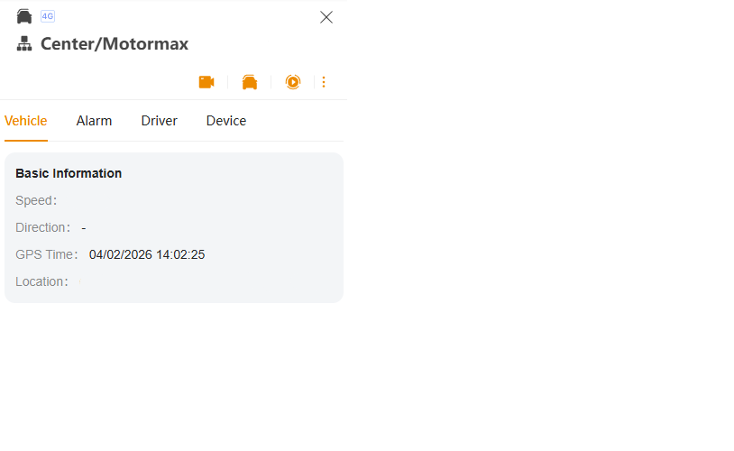
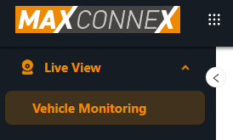
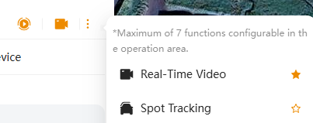
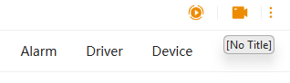
Card Style Layout
3
When you click on a vehicle you will be shown the basic information relating to the device and the shortcut for live view. If this shortcut has been disabled, you can turn it back on by hovering over the 3 dots.
1
Under the Live View tab on the left-hand side, open the vehicle monitoring tab.
2
With the Card Style option selected, the vehicles will show like this in the vehicle list. You can select them by clicking on it.
4
Clicking on the camera icon will open the live view for this device if it is online. Online vehicles will show with a green dot next to the registration.

Slide 6
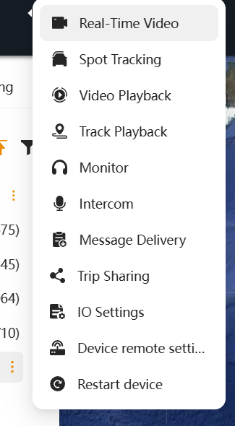
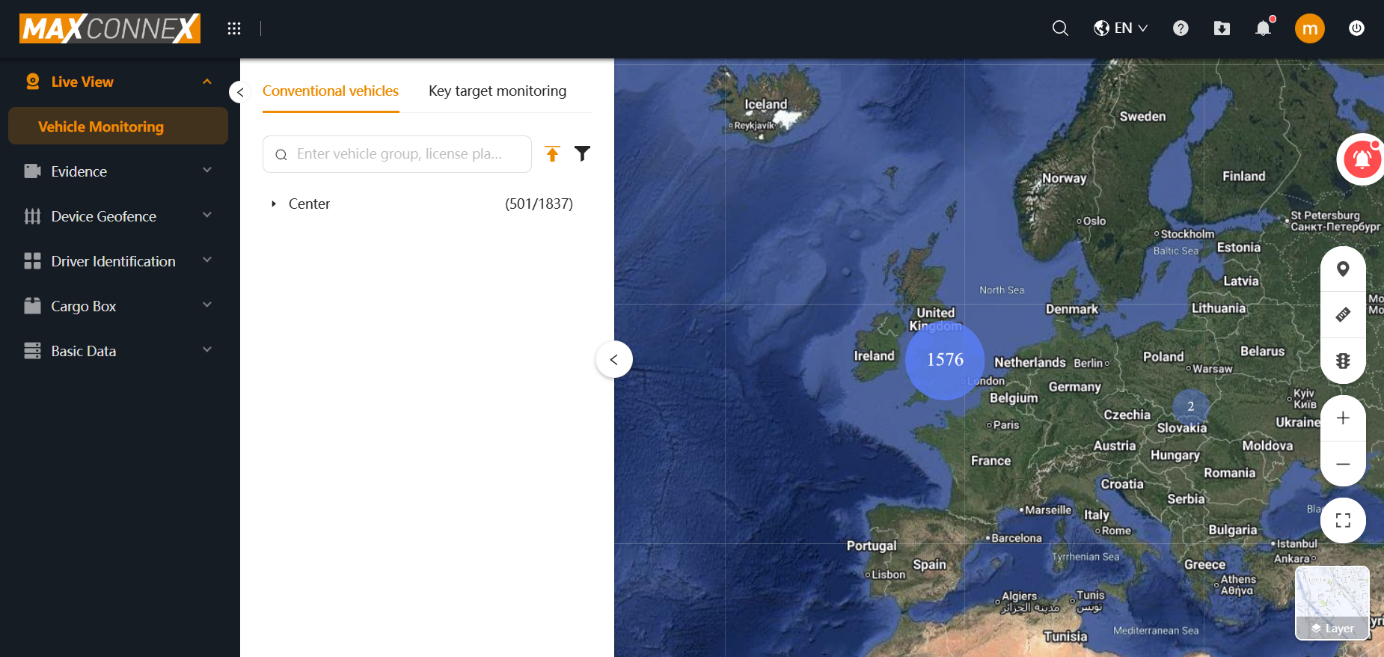
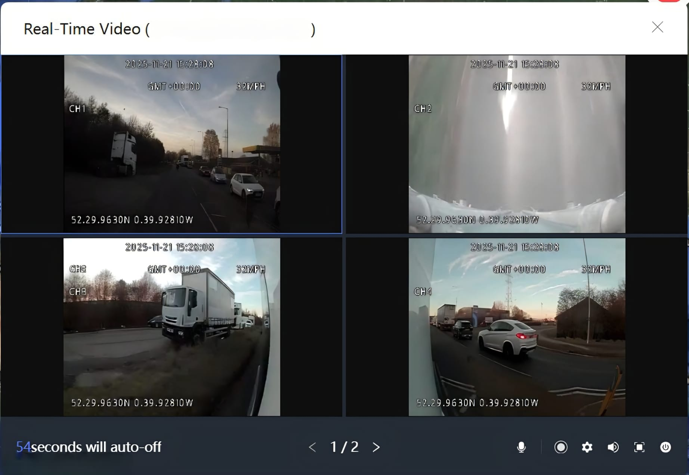
Tree Style Layout
1
Once you are loaded into the platform, you will be greeted with the world map and several options down the left-hand side. Please select Live view, then Vehicle monitoring.
3
When hovering over the 3 dots, you will be presented with all your available options. You will need to select Real-Time Video at the top.
2
Under Conventional vehicles, Find your desired fleet and vehicle. Once you have found your desired vehicle, hover your cursor over the registration to show the 3 dots on the right-hand side.
4
You will automatically be shown a maximum of 4 cameras. If you have more cameras on this system, you can cycle through using the arrows at the bottom.
You can full screen these views by pressing the square icon in the bottom right.

Slide 7
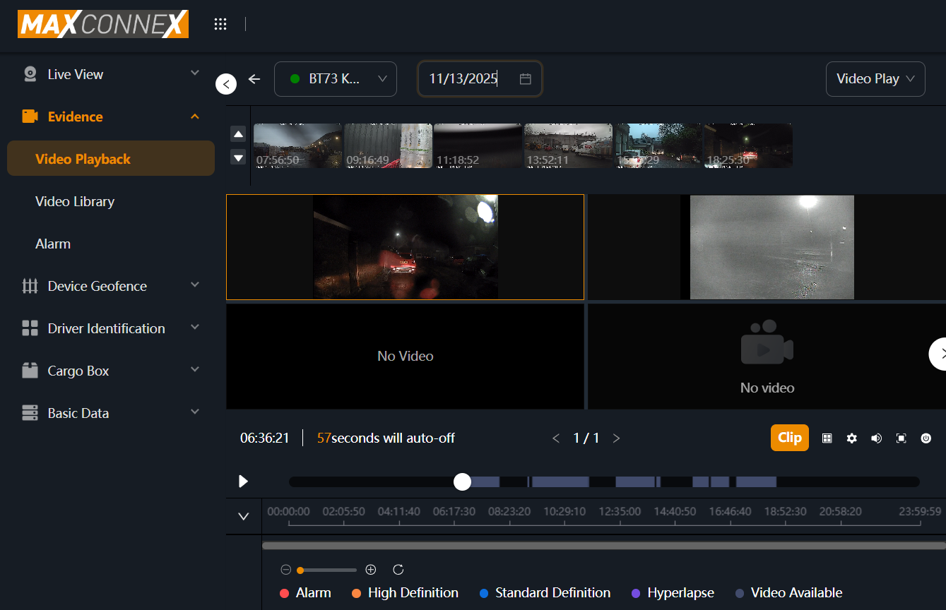
Downloading Footage

Slide 8
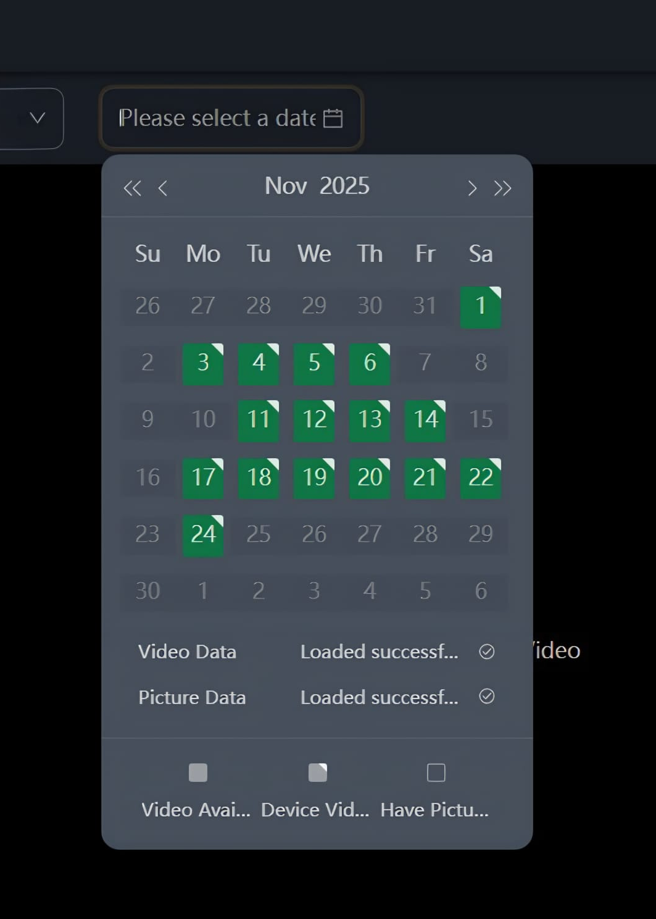
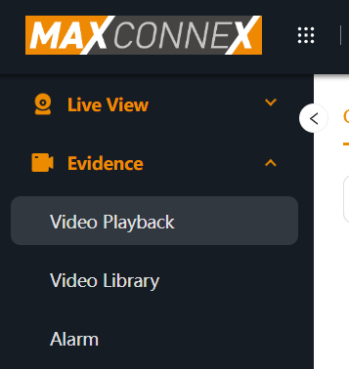
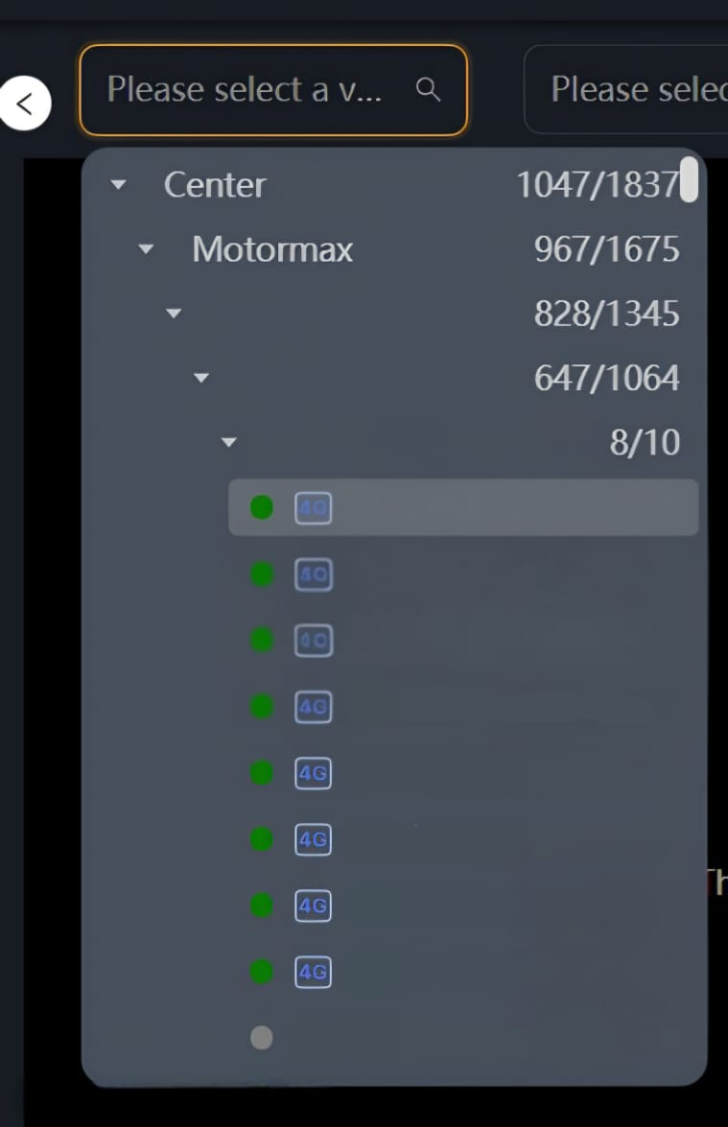
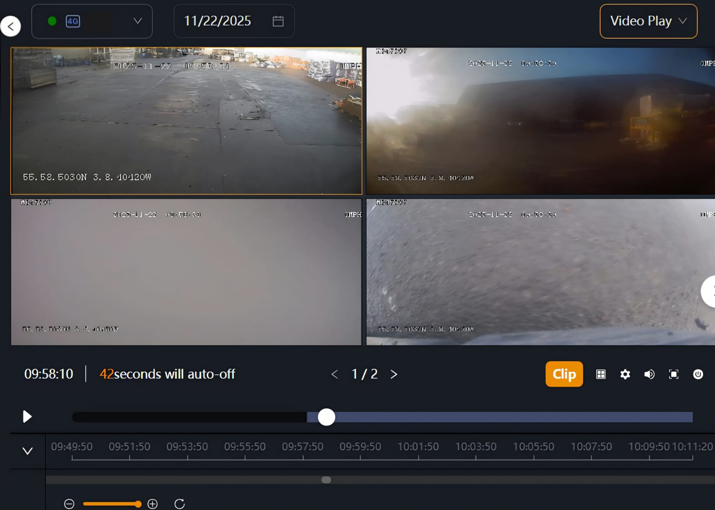
1
In the main directory on the left-hand side of the page. Select Evidence, then Video Playback.
3
Select the date you want. Dates where the vehicle has been recording will be marked as green.
4
Make sure Video Play is selected in the top right. This will allow you to click and drag the dot through the vehicle's timeline. When you know the start time and length for the footage you are downloading, you can press the Clip button in the bottom right and then confirm.
2
Select the vehicle you want to look at. This vehicle will need to be online and showing the green circle next to its registration.

Slide 9
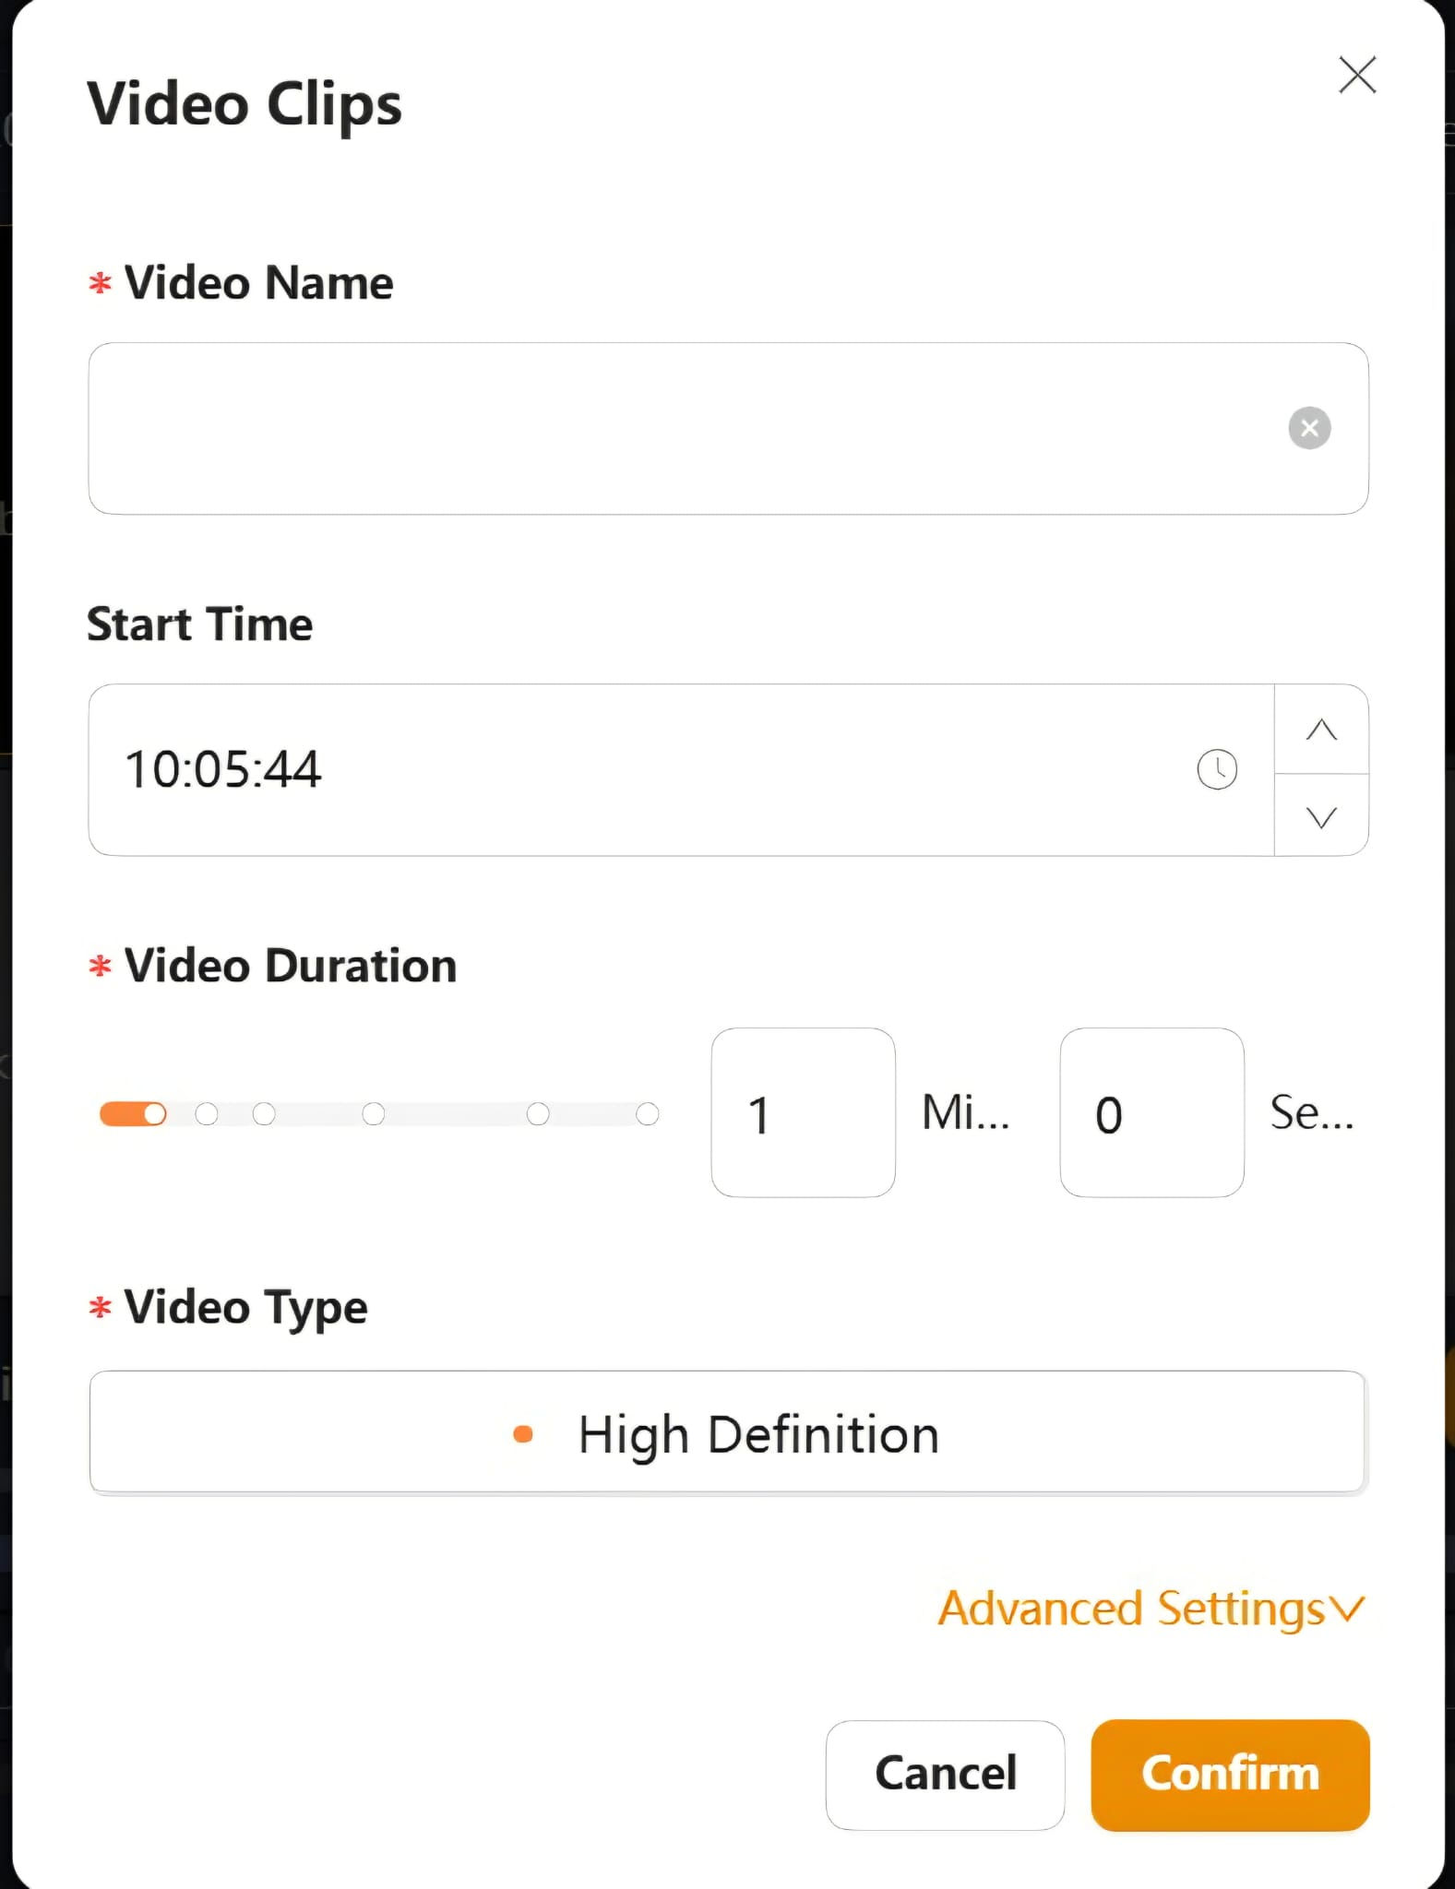
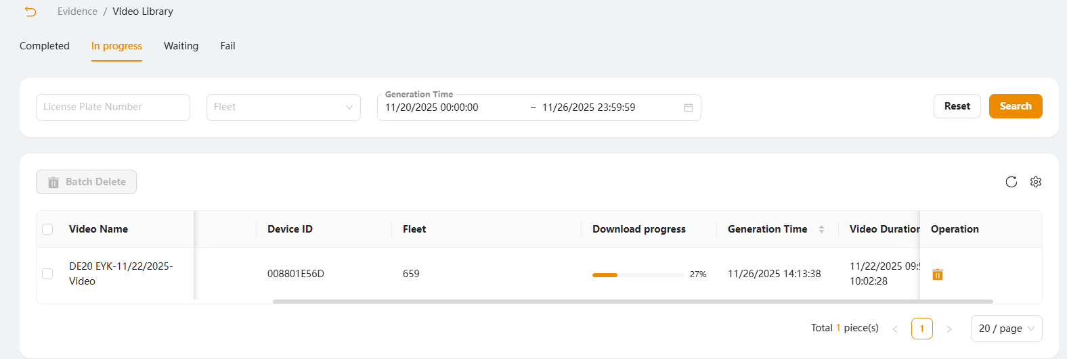
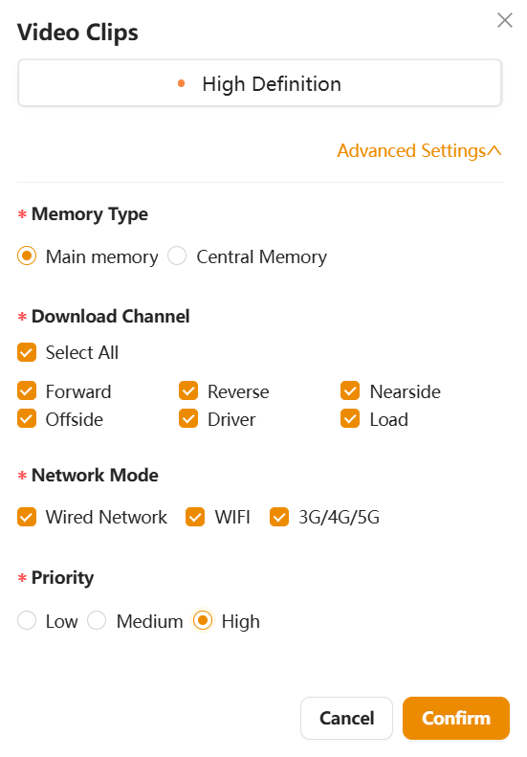
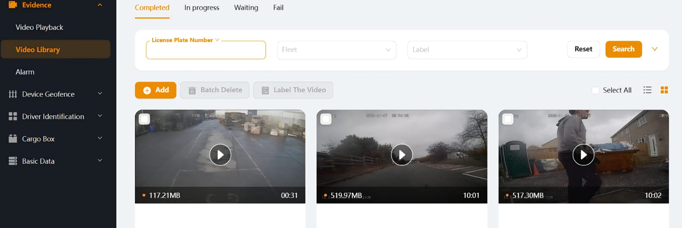
5
The Clip menu will show you the options for your footage download. Once you have entered your video start time, you will need to add the duration of the clip. This is limited to 10 minutes maximum. Once this is selected you will need to make sure that the type is set to high definition.
7
Once you have confirmed this clip, it will be found in progress in the video library. Note that the vehicle going offline can more this task to ‘Waiting’
6
Under the advanced settings tab. You can specify what specific channels you want to record. These may not be labelled as the names are set in the DVR.
Priority will need to be set to high else this may get lost in the download queue.
8
Once this footage has downloaded. It will be located under Evidence and Video Library. From there you will need to search for the desired footage by registration.

Slide 10
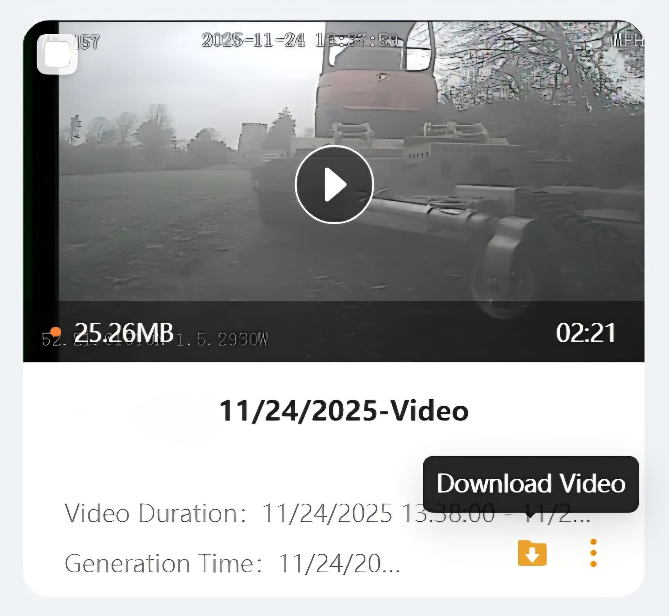
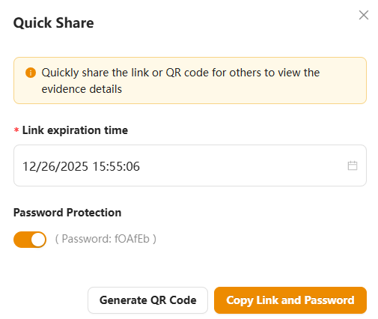
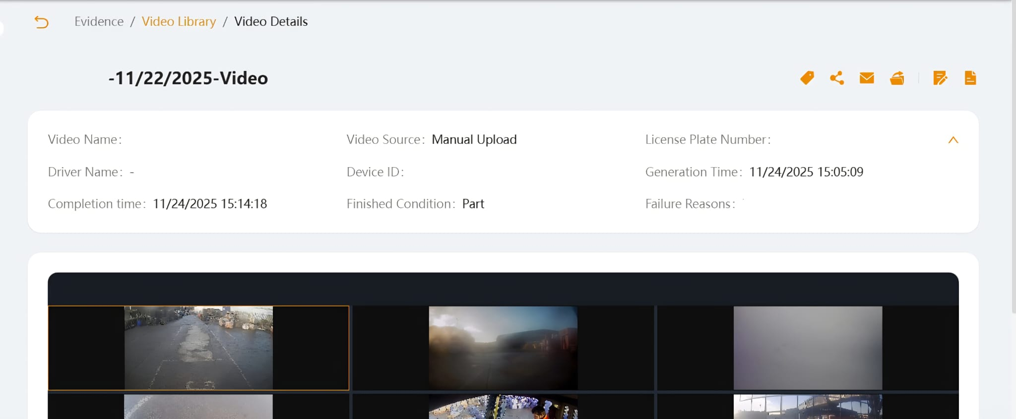

9
Once this footage has downloaded to the Video Library. You can download this footage to your computer by pressing the File button in the bottom right.
11
When quick-sharing the footage, you will be asked if you have a desired expiration time and as to whether it needs to be password protected. If you are sending this information to third parties, please remember to send them the password too.
If you press the copy link button, you will be given a URL to send to someone.
10
By clicking on the footage in the video library. You can quick share this video via a web-link by pressing n on the top right of this menu.

Slide 11
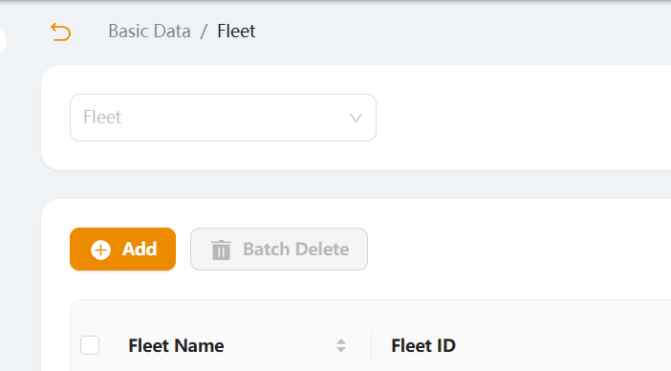
Adding Fleets

Slide 12
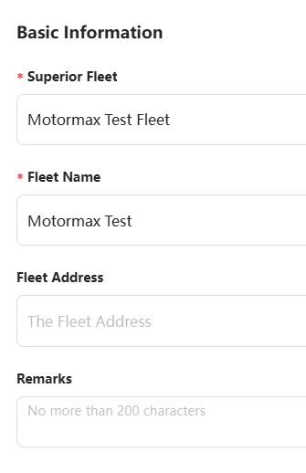
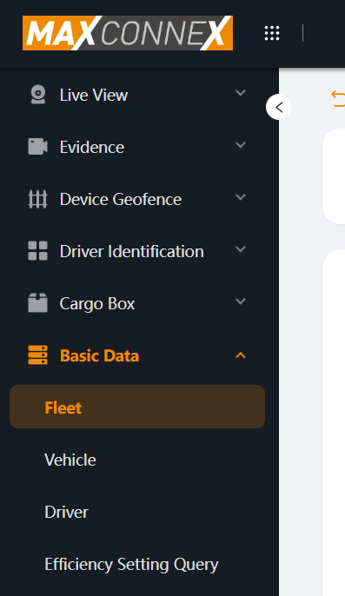
Adding Fleets
1
Under Basic Data on the left there will be options for Vehicle and Fleet. Select the Fleet option under basic data.
3
Under Superior Fleet you will need to assign a new fleet to your desired parent fleet. If you are an installer, this will likely be the highest fleet you have access to.
The Fleet name will need to be added while the Address and the Remarks are not mandatory.
2
When inside the Fleet tab. You will need to press the add button.

Slide 13
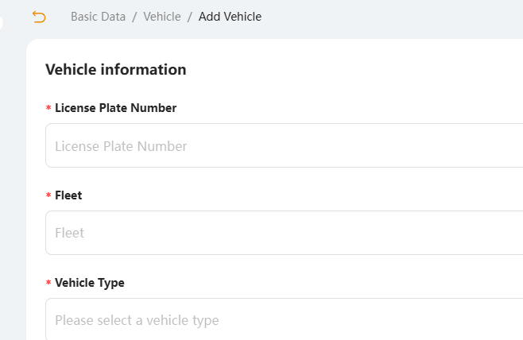
Adding Vehicles

Slide 14
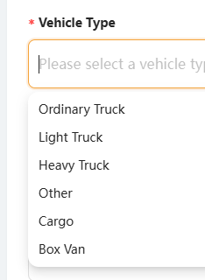
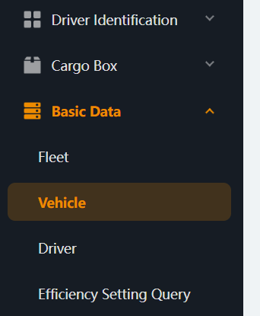
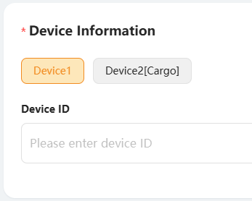
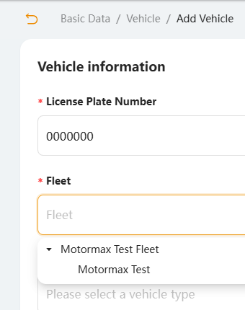
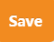
Adding Vehicles
4
Select the vehicle type in the drop-down menu. If your vehicle does not match any of these descriptions, click other.
1
Select the Vehicle option under Basic Data.
2
When inside the vehicle tab. You will need to press the add button.
5
In device information, you will need to input the DVR’s serial number, which can be found by logging into the device. When your details are confirmed, click the button on the bottom right of this menu
3
Add the Vehicle Registration Number and the fleet it is assigned.

Slide 15
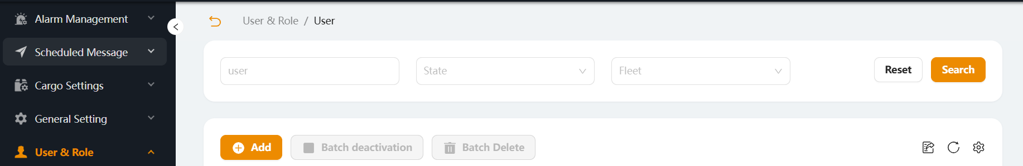
Adding Users

Slide 16
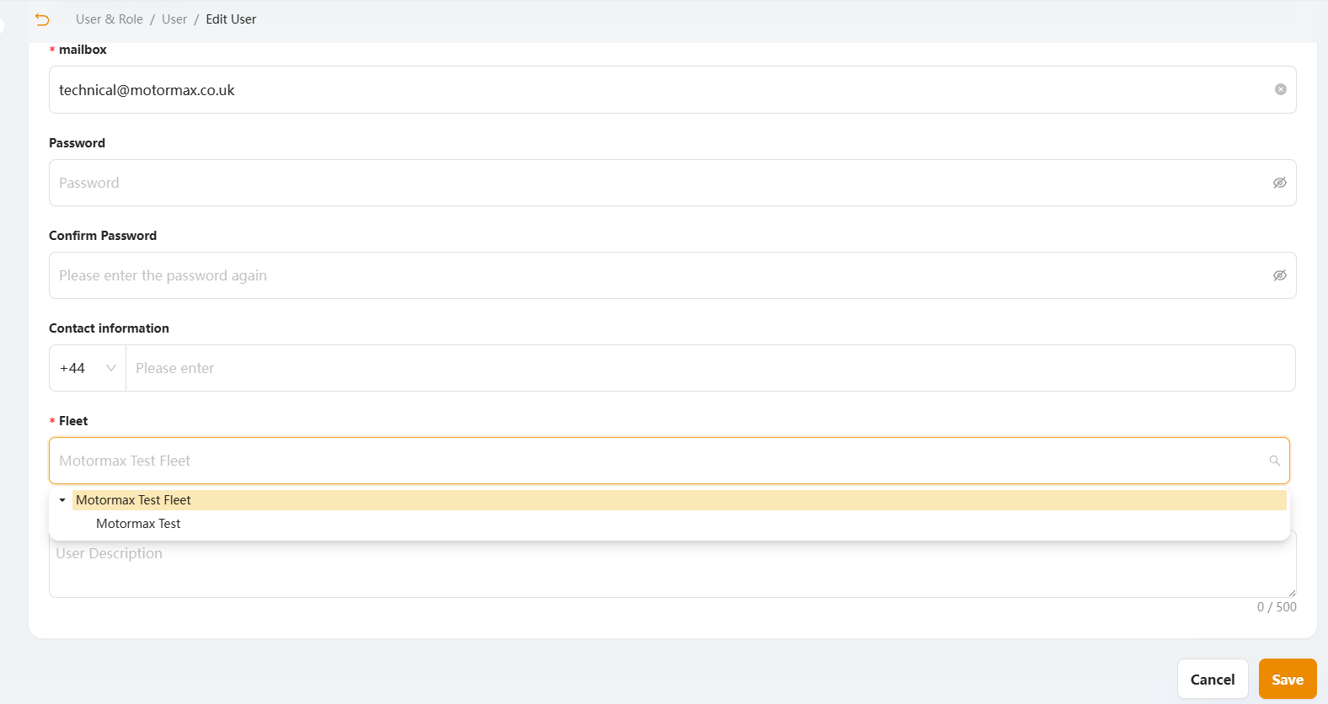
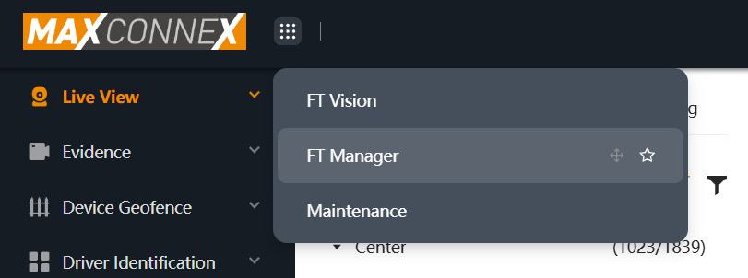
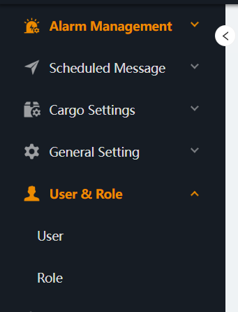
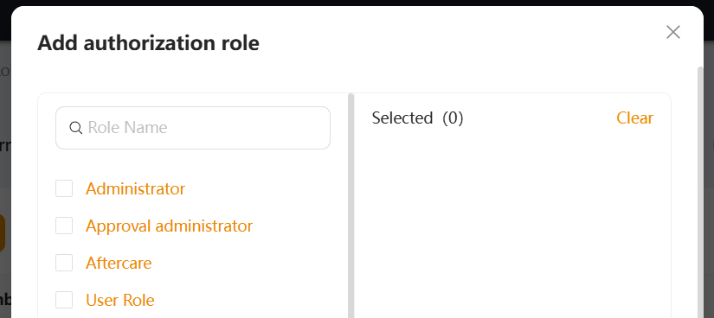
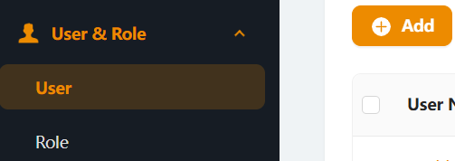
4
In the add user form, you will need to enter a Username (email is preferred), an email address and create a password. You will also need to add what fleet will be visible to this user.
1
On the main page, Click the 9 white dots and enter FT manager.
2
In the menu on the left, you will have a drop down for User & Role
5
Once the user details have been added, you will be asked to add an authorisation role. These authorisation roles will determine what settings and features the user can use. If you are a customer reseller, you will usually assign new customers to customer basic. This will mean they can only view and download footage.
3
Click the Add button
Notes:
Mention in step 4 that an email is preferred in the username.
Show a screenshot of when you are choosing a fleet to attach the user to.

Slide 17
Why is my vehicle or selected date showing as red?
When a vehicle or a date is showing as red, this means that there is currently an alarm on the DVR. This could be a fault due to voltage, storage or an incorrectly named trigger.
Check that the IO triggers in your DVR are set to events as opposed to alarms.
Make sure to make note of what the alarms are under the evidence tab and Alarm. This will give you a full list of alarms that can be filtered by date and time.
Why is my vehicle showing as orange in live view?
When a vehicle is showing as orange on live view, this means that the device is currently in sleep mode.
This is usually set for vehicles that are in constant use and is used to remote wake up the devices.
These settings will be found in the DVR under General, Startup and wake.
Why is my live view footage or downloads slow?
This can be due to poor signal in the area or interference with the 4G antenna.
If video playback is slow, try only viewing one or two channels at a time, This is especially important with larger systems with many cameras.
Continual issues with this could be due to the SIM card itself or the antenna placement in the vehicle. For example, if the antenna is close to a DAB ariel it can cause issues with both the DAB and the signal strength for the recorder.
Why is my vehicle greyed out?
If your vehicle is greyed out on live view this means that the DVR is not reporting. This could be due to the vehicle not being used or a fault in the DVR or SIM card.
If the DVR is not reporting and the SIM has been checked, make sure to check the server settings inside the DVR.
What does video loss mean?
If you have a channel that is showing as video loss, this can either mean a camera fault or connection has come loose.
Be sure to check camera connections into the DVR and any possible extension cables. If the issue persists then it will be a case of replacing the camera.
What does no signal mean?
When a channel is showing as no signal, this usually indicates that a channel has been deactivated in the DVR.
Make sure to check the DVR recording settings as this will cause it to not record anything in that channel.
Common Issues and Fixes
What does poor network timeout mean?
When live view shows the message no signal timeout, this usually indicates that the DVR is struggling for signal.
This can also mean as you are viewing the footage, the vehicle has turned off.
Be sure to check the DVR network settings to be sure that it is not an issue directly related to the SIM card.
Why can't I search for my vehicle?
When viewing a vehicle, specifically in larger fleets, you may need to search for the vehicle by registration in the live view tab.
Depending on who commissioned the vehicle or when, the vehicle may have been named something different to the registration. If the system was installed before you registered the vehicle, it may be listed as the chassis number.
If searching for the reg or chassis number doesn’t help, you can also search for the device serial number. This is usually on a sticker on the device itself.
Why can't I open or view downloaded footage?
If you have downloaded footage to your computer and you cannot open or play it, this could be due to the video being password protected when the link was shared.
If this is the case, a new link can be shared by the video owner either with the password or without entirely.
If privacy is a concern, these links can have expiration dates set to your liking, whether that is 5 minutes or 30 days.
Why can't I add new users or vehicles?
If you cannot add new users or vehicles to the platform, this will be due to the permissions you have been given via the user and role setup.
If you feel the permissions you have been given are incorrect, this can be changed by your installer/reseller.
Please take into consideration that they also may have restricted access. If specific roles are needed for something, feel free to contact us.

